Slide 1

DEPARTMENT OF COMPUTER SCIENCE & ENGINEERING (ALLENHOUSE INSTITUTE OF TECHNOLOGY, KANPUR) (Dr. A. P. J. Abdul Kalam Technical University, Lucknow, Uttar Pradesh) MINI PROJECT Presentation HOTEL MANAGEMENT SYSTEM
submitted to SUBMITTED BY
Dr. Pradeep Kumar Pranshu Pal
(Mini Project Coordinator) (2105051530075)

Slide 2

AGENDA
INTRODUCTION
IMPORATANCE
KEY FEATURES
SOFTWARE REQUIREMENTS
DFD
BENEFITS
SYSTEM ARCHITECTURE
CONCLUSION

Slide 3
Introduction
The Hotel Management System is a comprehensive software solution designed to streamline and automate various operations within a hotel, enhancing overall efficiency and guest satisfaction. This project addresses the complexities associated with managing different facets of hotel operations, including reservation management, room allocation, billing, inventory tracking, and reporting.
This project is used by two types of users:
Hotel Admin
Hotel Staff

Slide 4
IMPORATANCE OF HOTEL MANAGEMENT SYSTEM
Operational Efficiency
Enhanced Guest Experience
Revenue Management
Centralized Control
Reporting and Analytics
Improved Communication
Cost Savings
Scalability

Slide 5
KEY FEATURES OF HOTEL MANAGEMENT SYSTEM
Reservation Management
Check-in/Check-out
Billing and Invoicing
Guest Profiles
Reporting and Analytics
Channel Management
Security and Authentication
Customer Relationship Management (CRM)

Slide 6
SOFTWARE REQUIREMENTS
Hardware Specifications:
• Computer with a 1.1 GHz or faster processor
• Minimum 2GB of RAM or more
• 2.5 GB of available hard-disk space
• 5400 RPM hard drive
• 1366 × 768 or higher-resolution display
• DVD-ROM drive
Software Specifications:
Operating System: Windows 10
Google Chrome/Internet Explorer
XAMPP (Version-3.7)
Python main editor (user interface): PyCharm Community
workspace editor: Sublime text 3

Slide 7
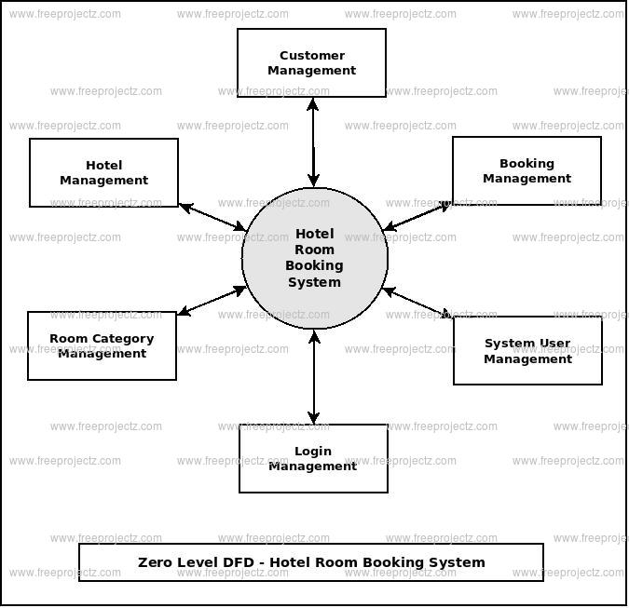
DATA FLOW DIAGRAM

Slide 8
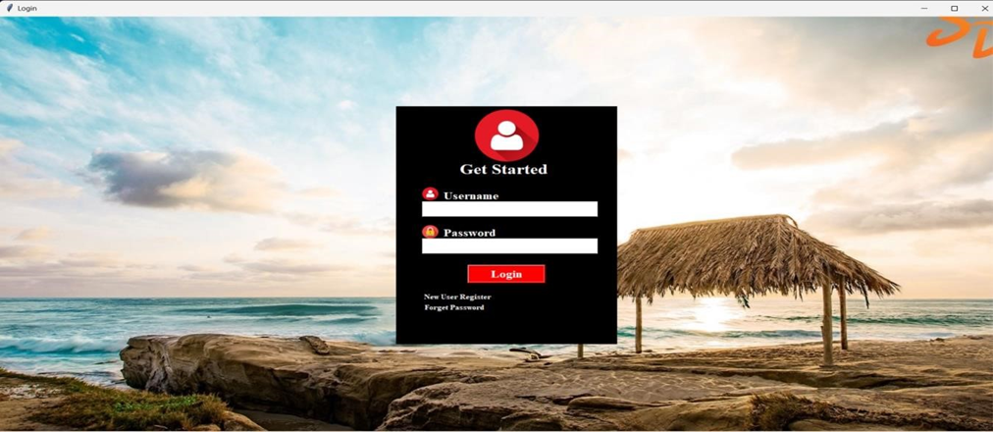
USER WINDOW

Slide 9
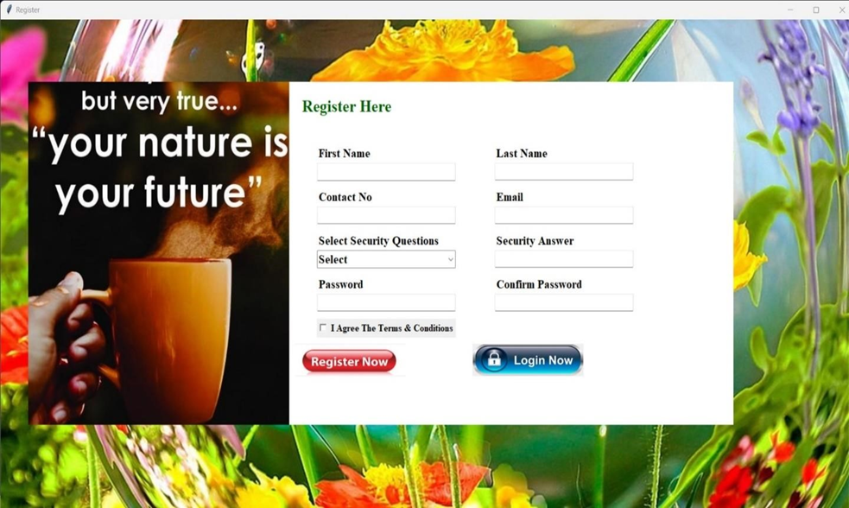
NEW USER WINDOW

Slide 10
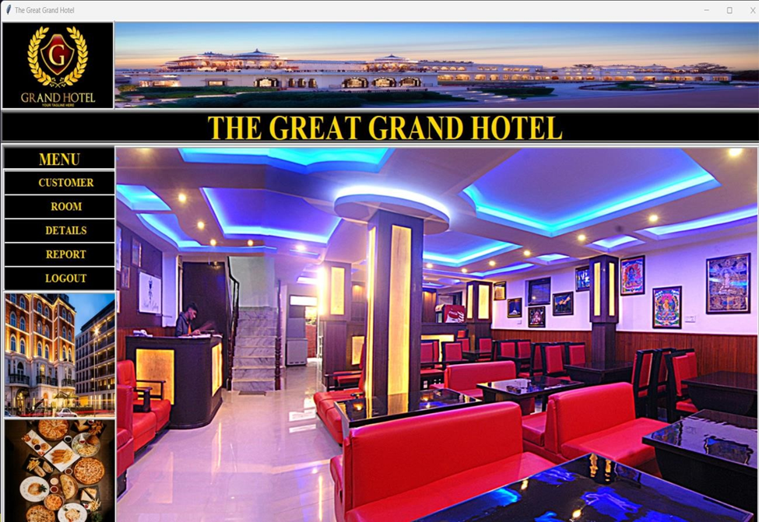
MAIN WINDOW

Slide 11
BENEFITS
Time Savings
Improved Guest Satisfaction
Revenue Optimization
Centralized Control
Scalability

Slide 12
System architecture
Front Desk Module
Reservation System
Billing and Invoicing
Reporting and Analytics
Central Database

Slide 13
conclusion
Summary:
A Hotel Management System is an indispensable tool for modern hotels, offering efficiency, improved guest satisfaction, and enhanced revenue management.
Call to Action:
Consider the implementation of an HMS to stay competitive and elevate your hotel's operational standards.

Slide 14
THANK YOU

